Slide 1
Multiple Discriminant Analysis and Logistic Regression

Slide 2
Multiple Discriminant Analysis
Appropriate when dep. var. is categorical and indep. var. are metric
MDA derives variate that best distinguishes between a priori groups
MDA sets variate’s weights to maximize between-group variance relative to within-group variance

Slide 3
MDA
For each observation we can obtain a Discriminant Z-score
Average Z score for a group gives Centroid
Classification done using Cutting Scores which are derived from group centroids
Statistical significance of Discriminant Function done using distance bet. group centroids
LR similar to 2-group discriminant analysis

Slide 4
The MDA Model
Six-stage model building for MDA
Stage 1: Research problem/Objectives
a. Evaluate differences bet. avg. scores for a priori groups on a set of variables
b. Determine which indep. variables account for most of the differences bet. groups
c. Classify observations into groups

Slide 5
The MDA Model
Stage 2: Research design
a. Selection of dep. and indep. variables
b. Sample size considerations
c. Division of sample into analysis and holdout sample

Slide 6
The MDA Model
Stage 3: Assumptions of MDA
a. Multivariate normality of indep. var.
b. Equal Covariance matrices of groups
c. Indep. vars. should not be highly correlated.
d. Linearity of discriminant function
Stage 4: Estimation of MDA and assessing fit
a. Estimation can be
i. Simultaneous
ii. Stepwise

Slide 7
The MDA Model
Step 4: Estimation and assessing fit (contd)
b. Statistical significance of discrim function
i. Wilk’s lambda, Hotelling’s trace, Pillai’s criterion, Roy’s greatest root
ii. For stepwise method, Mahalanobis D² , iii. Test stat sig. of overall discrimination between groups and of each discriminant function

Slide 8
MDA and LR (contd)
Step 4: Estimation and assessing fit (contd)
c. Assessing overall fit
i. Calculate discrim. Z-score for each obs.
ii. Evaluate group differences on Z scores
iii. Assess group membership prediction accuracy. To do this we need to address following
- rationale for classification matrices

Slide 9
The MDA Model
Step 4: Estimation and assessing fit (contd)
c. Assessing overall fit(contd.)
iii. Address the following (contd.)
- cutting score determination
- consider costs of misclassification
- constructing classification matrices
- assess classification accuracy
- casewise diagnostics

Slide 10
The MDA Model
Stage 5: Interpretation of results
a. Methods for single discrim. function
i. Discriminant weights
ii. Discriminant loadings
iii. Partial F-values
b. Additional methods for more than 2 functions
i. Rotation of discrim. functions
ii. Potency index
iii. Stretched attribute vectors

Slide 11
The MDA Model
Stage 6: Validation of results

Slide 12
Logistic Regression
For 2 groups LR is preferred to MDA because
1. More robust to failure of MDA assumptions
2. Similar to regression, so intuitively appealing
3. Has straightforward statistical tests
4. Can accommodate non-linearity easily
5. Can accommodate non-metric indep var. through dummy variable coding

Slide 13
The LR Model
Six stage model building for LR
Stage 1: Research prob./objectives (same as MDA)
Stage 2: Research design (same as MDA)
Stage 3: Assumptions of LR (same as MDA)
Stage 4: Estimating LR and assessing fit
a. Estimation uses likelihood of an event’s occurrence

Slide 14
The LR Model
Stage 4: Estimating LR and assessing fit (contd)
b. Assessing fit
i. Overall measure of fit is -2LL
ii.Calculation of R² for Logit
iv. Assess predictive accuracy

Slide 15
The LR Model
Step 5: Interpretation of results
a. Many MDS methods can be used
b. Test significance of coefficients
Step 6: Validation of results

Slide 16
Example: Discriminant Analysis
HATCO is a large industrial supplier
A marketing research firm surveyed 100 HATCO customers
There were two different types of customers: Those using Specification Buying and those using Total Value Analysis
HATCO mgmt believes that the two different types of customers evaluate their suppliers differently

Slide 17
Example: Discriminant Analysis
In a B2B situation, HATCO wanted to know the perceptions that its customers had about it
The mktg res firm gathered data on 7 variables
1. Delivery speed
2. Price level
3. Price flexibility
4. Manufacturer’s image
5. Overall service
6. Salesforce image
7. Product quality
Each var was measured on a 10 cm graphic rating scale
Poor
Excellent

Slide 18
Example: Discriminant Analysis
Stage 1: Objectives of Discriminant Analysis
Which perceptions of HATCO best distinguish firms using each buying approach?
Stage 2: Research design
a. Dep var is the buying approach of customers. It is categorical. Indep var are X₁ to X₇ as mentioned above
b. Overall sample size is 100. Each group exceeded the minimum of 20 per group
c. Analysis sample size was 60 and holdout sample size was 40

Slide 19
Example: Discriminant Analysis
Stage 3: Assumptions of MDA
All the assumptions were met
Stage 4: Estimation of MDA and assessing fit
Before estimation, we first examine group means for X₁ to X₇ and the significances of difference in means
a. Estimation is done using the Stepwise procedure.
- The indep var which has the largest Mahalanobis D² distance is selected first and so on, till none of the remaining var are significant
- The discriminant function is obtained from the unstandardized coefficients

Slide 20
Example: Discriminant Analysis
Stage 4: Estimation of MDA and assessing fit (cont)
b. Univariate and multivariate aspects show significance
c. Discrim Z-score for each observation and group centriods were calculated
- The cutting score was calculated as -0.773
- Classification matrix was calculated by classifying an observation as Specification buying/Total value analysis if it’s Z-score was less/greater than –0.773
- Classification accuracy was obtained and assessed using certain benchmarks

Slide 21
Example: Discriminant Analysis
Step 5: Interpretation
-Since we have a single discriminant function, we will look at the discriminant weights, loadings and partial F values
- Discriminant loadings are more valid for interpretation. We see that X₇ discriminates the most followed by X₁ and then X₃
- Going back to table of group means, we see that firms employing Specification Buying focus on ‘Product quality’, whereas firms using Total Value Analysis focus on ‘Delivery speed’ and ‘Price flexibility’ in that order

Slide 22
Example: Logistic Regression
A cataloger wants to predict response to mailing
Draws sample of 20 customers
Uses three variables
- RESPONSE (0=no/1=yes) the dep var
- AGE (in years) an indep var
- GENDER (0=male/1=female) an indep var
Use Dummy variables for categorical variables

Slide 23
Example: Logistic Regression
Running the logistic regression program gives
G = -10.83 + .28 AGE +2.30 GENDER
Here G is the Logit of a yes response to mailing
Consider a male of age 40. His G or logit score is
G(0, 40) = -10.83 + .28*40 + 2.30*0 = .37 logit
A female customer of same age would have
G(1, 40) = -10.83 + .28*40 + 2.30*1 = 2.67 logits
Logits can be converted to Odds which can be converted to probabilities
For the 40 year old male/female prob is p = .59/.93

Slide 24
Factor Analysis
© 2007 Prentice Hall

Slide 25
Chapter Outline
1) Overview
2) Basic Concept
3) Factor Analysis Model
4) Statistics Associated with Factor Analysis

Slide 26
Chapter Outline
5) Conducting Factor Analysis
  Problem Formulation
  Construction of the Correlation Matrix
  Method of Factor Analysis
  Number of of Factors
  Rotation of Factors
  Interpretation of Factors
  Factor Scores
  Model Fit

Slide 27
Factor Analysis
Factor analysis is a class of procedures used for data reduction and summarization.
It is an interdependence technique: no distinction between dependent and independent variables.
Factor analysis is used:
  To identify underlying dimensions, or factors, that explain the correlations among a set of variables.
  To identify a new, smaller, set of uncorrelated variables to replace the original set of correlated variables.

Slide 28
Factors Underlying Selected Psychographics and Lifestyles
Fig. 19.1
Factor 2
Football
Baseball
Evening at home
Factor 1
Go to a party
Home is best place
Plays
Movies

Slide 29
Factor Analysis Model
Each variable is expressed as a linear combination of factors. The factors are some common factors plus a unique factor. The factor model is represented as:
X_{i} = A_{i 1}F₁ + A_{i 2}F₂ + A_{i 3}F₃ + . . . + A_{im}F_{m} + V_{i}U_{i}
where
X_{i} = i th standardized variable
A_{ij} = standardized mult reg coeff of var i on common factor j
F_{j} = common factor j
V_{i} = standardized reg coeff of var i on unique factor i
U_{i} = the unique factor for variable i
m = number of common factors

Slide 30
Factor Analysis Model
The first set of weights (factor score coefficients) are chosen so that the first factor explains the largest portion of the total variance.
Then a second set of weights can be selected, so that the second factor explains most of the residual variance, subject to being uncorrelated with the first factor.
This same principle applies for selecting additional weights for the additional factors.

Slide 31
Factor Analysis Model
The common factors themselves can be expressed as linear combinations of the observed variables.
F_{i} = W_{i1}X₁ + W_{i2}X₂ + W_{i3}X₃ + . . . + W_{ik}X_{k}
Where:
F_{i} = estimate of i th factor
W_{i}= weight or factor score coefficient
k = number of variables

Slide 32
Statistics Associated with Factor Analysis
Bartlett's test of sphericity. Bartlett's test of sphericity is used to test the hypothesis that the variables are uncorrelated in the population (i.e., the population corr matrix is an identity matrix)
Correlation matrix. A correlation matrix is a lower triangle matrix showing the simple correlations, r, between all possible pairs of variables included in the analysis. The diagonal elements are all 1.

Slide 33
Statistics Associated with Factor Analysis
Communality. Amount of variance a variable shares with all the other variables. This is the proportion of variance explained by the common factors.
Eigenvalue. Represents the total variance explained by each factor.
Factor loadings. Correlations between the variables and the factors.
Factor matrix. A factor matrix contains the factor loadings of all the variables on all the factors

Slide 34
Statistics Associated with Factor Analysis
Factor scores. Factor scores are composite scores estimated for each respondent on the derived factors.
Kaiser-Meyer-Olkin (KMO) measure of sampling adequacy. Used to examine the appropriateness of factor analysis. High values (between 0.5 and 1.0) indicate appropriateness. Values below 0.5 imply not.
Percentage of variance. The percentage of the total variance attributed to each factor.
Scree plot. A scree plot is a plot of the Eigenvalues against the number of factors in order of extraction.

Slide 35
Example: Factor Analysis
HATCO is a large industrial supplier
A marketing research firm surveyed 100 HATCO customers, to investigate the customers’ perceptions of HATCO
The marketing research firm obtained data on 7 different variables from HATCO’s customers
Before doing further analysis, the mkt res firm ran a Factor Analysis to see if the data could be reduced

Slide 36
Example: Factor Analysis
In a B2B situation, HATCO wanted to know the perceptions that its customers had about it
The mktg res firm gathered data on 7 variables
1. Delivery speed
2. Price level
3. Price flexibility
4. Manufacturer’s image
5. Overall service
6. Salesforce image
7. Product quality
Each var was measured on a 10 cm graphic rating scale
Poor
Excellent

Slide 37
Conducting Factor Analysis
Fig. 19.2
Problem formulation
Construction of the Correlation Matrix
Method of Factor Analysis
Determination of Number of Factors
Rotation of Factors
Interpretation of Factors
Calculation of
Factor Scores
Determination of Model Fit

Slide 38
Formulate the Problem
The objectives of factor analysis should be identified.
The variables to be included in the factor analysis should be specified. The variables should be measured on an interval or ratio scale.
An appropriate sample size should be used. As a rough guideline, there should be at least four or five times as many observations (sample size) as there are variables.

Slide 39
Construct the Correlation Matrix
The analytical process is based on a matrix of correlations between the variables.
If the Bartlett's test of sphericity is not rejected, then factor analysis is not appropriate.
If the Kaiser-Meyer-Olkin (KMO) measure of sampling adequacy is small, then the correlations between pairs of variables cannot be explained by other variables and factor analysis may not be appropriate.

Slide 40
Determine the Method of Factor Analysis
In Principal components analysis, the total variance in the data is considered.
-Used to determine the min number of factors that will account for max variance in the data.
In Common factor analysis, the factors are estimated based only on the common variance.
-Communalities are inserted in the diagonal of the correlation matrix.
-Used to identify the underlying dimensions and when the common variance is of interest.

Slide 41
Determine the Number of Factors
A Priori Determination. Use prior knowledge.
Determination Based on Eigenvalues. Only factors with Eigenvalues greater than 1.0 are retained.
Determination Based on Scree Plot. A scree plot is a plot of the Eigenvalues against the number of factors in order of extraction. The point at which the scree begins denotes the true number of factors.
Determination Based on Percentage of Variance.

Slide 42
Rotation of Factors
Through rotation the factor matrix is transformed into a simpler one that is easier to interpret.
After rotation each factor should have nonzero, or significant, loadings for only some of the variables. Each variable should have nonzero or significant loadings with only a few factors, if possible with only one.
The rotation is called orthogonal rotation if the axes are maintained at right angles.

Slide 43
Rotation of Factors
Varimax procedure. Axes maintained at right angles
-Most common method for rotation.
-An orthogonal method of rotation that minimizes the number of variables with high loadings on a factor.
-Orthogonal rotation results in uncorrelated factors.
Oblique rotation. Axes not maintained at right angles
-Factors are correlated.
-Oblique rotation should be used when factors in the population are likely to be strongly correlated.

Slide 44
Interpret Factors
A factor can be interpreted in terms of the variables that load high on it.
Another useful aid in interpretation is to plot the variables, using the factor loadings as coordinates. Variables at the end of an axis are those that have high loadings on only that factor, and hence describe the factor.

Slide 45
Calculate Factor Scores
The factor scores for the i th factor may be estimated as follows:
F_{i} = W_{i1} X₁ + W_{i2} X₂ + W_{i3} X₃ + . . . + W_{ik} X_{k}

Slide 46
Determine the Model Fit
The correlations between the variables can be deduced from the estimated correlations between the variables and the factors.
The differences between the observed correlations (in the input correlation matrix) and the reproduced correlations (estimated from the factor matrix) can be examined to determine model fit. These differences are called residuals.

Slide 47
Another Example of Factor Analysis
To determine benefits from toothpaste
Responses were obtained on 6 variables:
V1: It is imp to buy toothpaste to prevent cavities
V2: I like a toothpaste that gives shiny teeth
V3: A toothpaste should strengthen your gums
V4: I prefer a toothpaste that freshens breath
V5: Prevention of tooth decay is not imp
V6: The most imp consideration is attractive teeth
Responses on a 7-pt scale (1=strongly disagree; 7=strongly agree)

Slide 48
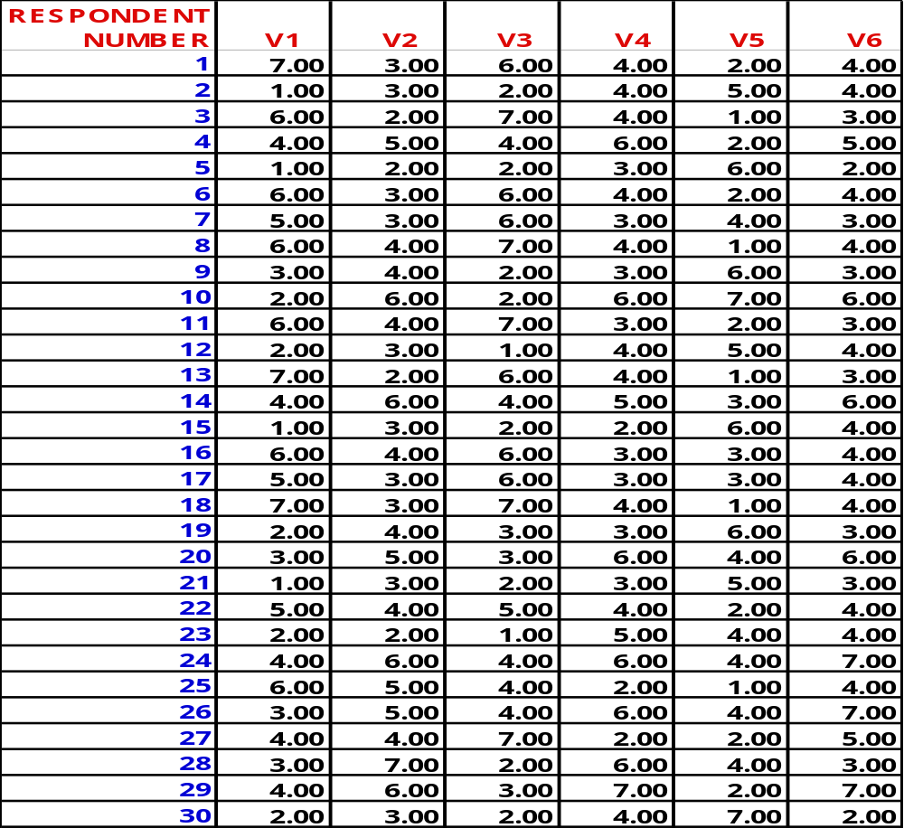
Another Example of Factor Analysis
Table 19.1

Slide 49
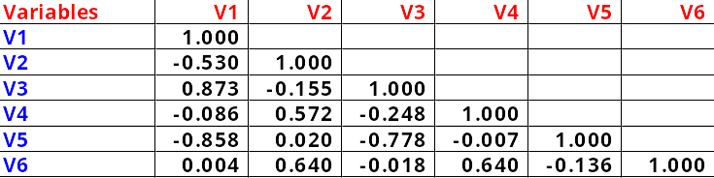
Correlation Matrix
Table 19.2

Slide 50
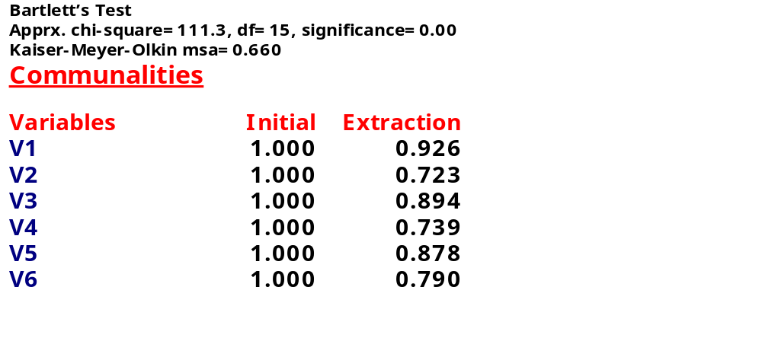
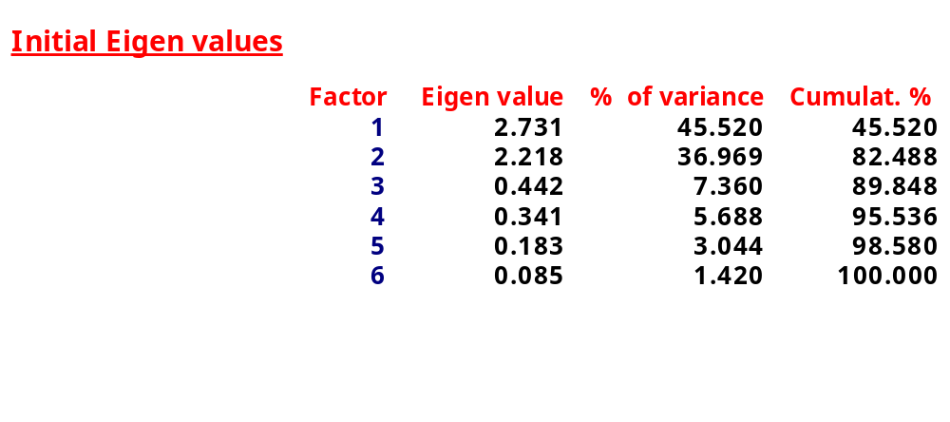
Results of Principal Components Analysis
Table 19.3

Slide 51
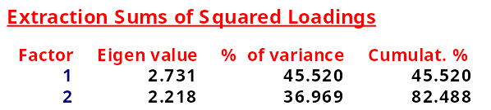
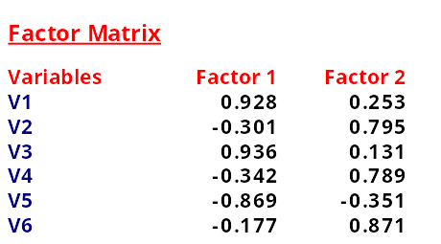
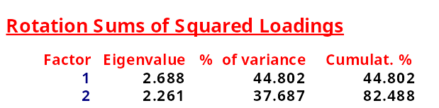
Results of Principal Components Analysis
Table 19.3, cont.

Slide 52
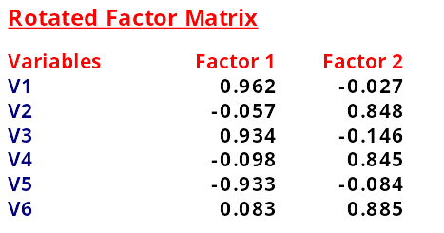
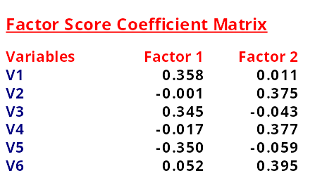
Results of Principal Components Analysis
Table 19.3, cont.

Slide 53
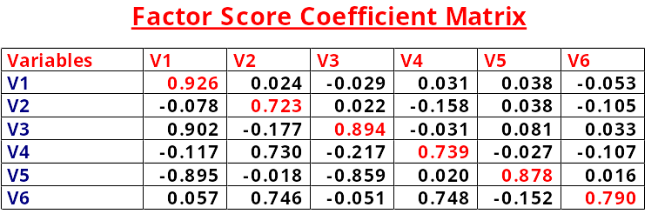
Results of Principal Components Analysis
Table 19.3, cont.
-The lower-left triangle is correlation matrix;
-The diagonal has the communalities;
-The upper-right triangle has the residuals between the
observed correlations and the reproduced correlations.

Slide 54
Scree Plot
Fig. 19.3
3.0
2.5
2.0
Eigenvalue
1.5
1.0
0.5
0.0
1
2
3
4
5
6
Component Number

Slide 55
Factor Matrix Before and After Rotation
Fig. 19.4
Factors
Factors
Variables
1
2
3
4
5
6
1
X
X
X
X
X
2
X
X
X
X
Variables
1
2
3
4
5
6
1
X
X
X
2
X
X
X
(a)
(b)
High Loadings
Before Rotation
High Loadings
After Rotation

Slide 56
Factor Loading Plot
Fig. 19.5
Rotated Component Matrix
Component Plot in
Rotated Space
Component 1 2
V1 0.962 -2.66E-02
V2 -5.72E-02 0.848
V3 0.934 -0.146
V4 -9.83E-02 0.854
V5 -0.933 -8.40E-02
V6 8.337E-02 0.885
V4
V6
1.0
0.5
0.0
-0.5
-1.0
V2
V1
Component 2
V5
V3
-1.0 -0.5 0.0 0.5 1.0
Component 1

Slide 57
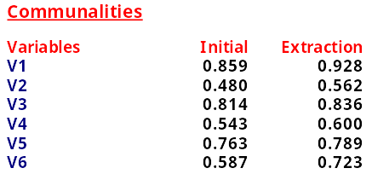
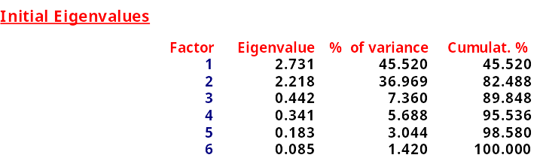
Results of Common Factor Analysis
Table 19.4
Barlett test of sphericity
Approx. Chi-Square = 111.314
df = 15
Significance = 0.00000
Kaiser-Meyer-Olkin measure of sampling adequacy = 0.660

Slide 58
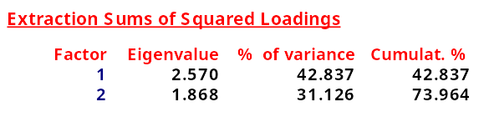
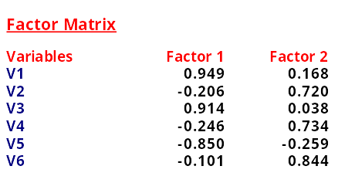
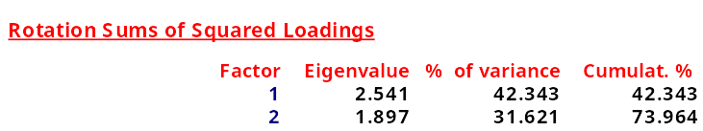
Results of Common Factor Analysis
Table 19.4, cont.

Slide 59
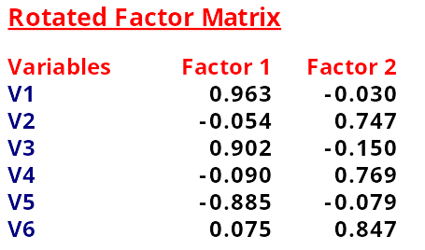
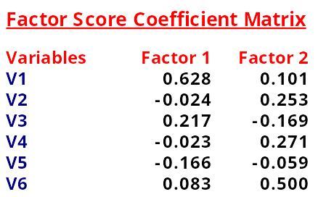
Results of Common Factor Analysis
Table 19.4, cont.

Slide 60
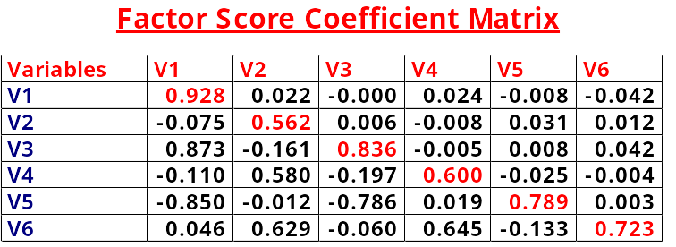
Results of Common Factor Analysis
Table 19.4, cont.
The lower-left triangle contains the reproduced
correlation matrix; the diagonal, the communalities;
the upper-right triangle, the residuals between the
observed correlations and the reproduced correlations.

